Slide 1

How Did We Do?
Brief overview of performance against each objective.
Super Simon
Jechiel van Dijk

Slide 2
Superposition
Classical versus quantum computing
Simon’s algorithm

Slide 3
Important
We live in 1 universe
In order to gain an intuitive sense, we will split this universe in 2
The classical realm
And the quantum realm
The same Information are described differently between these 2 realms

Slide 4
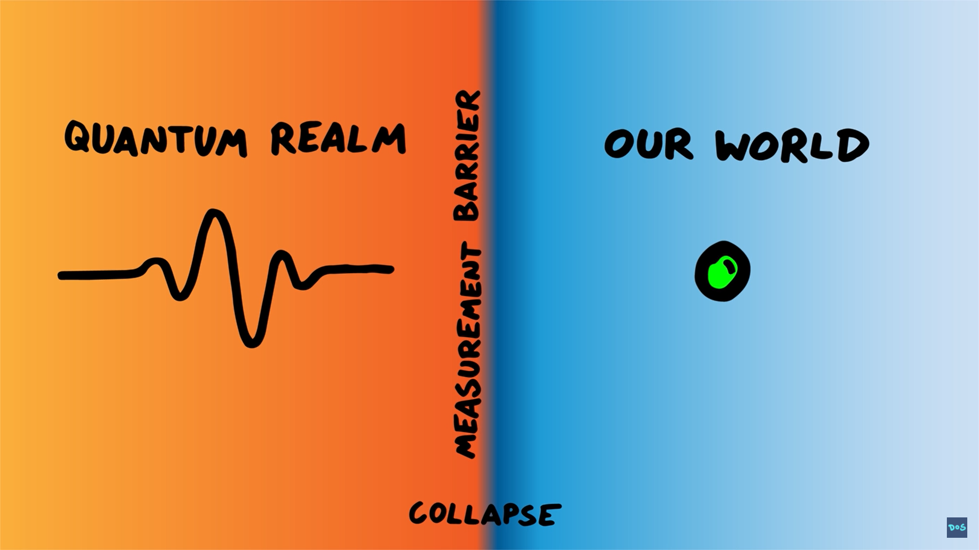

Slide 5



Properties in the classical world:
Properties in the Quantum world:
Color: Green
Weight: Heavy
Position:
Charge: Positive
Position:
Stepping into the Quantum World
Over here
Over here
3
3

Slide 6
In the quantum world a particle can be though of
as probability waves
Particle is now a wave like these two
This particle is at 2 places at the same time
Probability
3
5
Position

Slide 7
Takeaways
1
2
This is a possible representation of a wavefunction
This wave is at two places
at the same time
Probability
3
5
Position

Slide 8



The logic of a classical computer
An average chip in your phone has approx.
250 million transistors
One transistor (or bit) can be though of as a coin
Example: the letter A is represented by the following sequence of 8 bits
0
1
0
0
0
0
1
0
1
0
0
0
0
1

Slide 9
Here is the Quantum
1
and
0
Let's take 2 coins
The possible configurations are:
Classical computer can be in 1 of these state
1
1
1
Quantum computer can be in a superposition of these state
1
0
0
1
0
0
0
0
0
1
1
0
1
1

Slide 10


Quantum algorithms
Algorithms
(gates)
Start state
Measurement
These represent the qubit
Superposition only happens here

Slide 11
Simon’s Algorithm:
H
Black Box
H
0
0
0
0
f(x)
0
0

Slide 12
Simons algorithm example
Given a function
(in binary)
x | f(x)
000 | 010
001 | 101
010 | 101
011 | 010
100 | 110
101 | 001
110 | 001
111 | 110
Algorithms
(gates)
1
001
This algorithm will use 6 qubit. (twice the functions input)
2
+
3
011
4
=
5
010
6
7
8
Black Box
The black box exist out of quantum gates
which differ for every situation
find the period
The black box ‘encodes’ our function
Its 011 in this case
(Add 011 to x gets the same f(x))

Slide 13
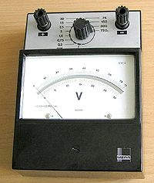
Simon’s Algorithm:
H
Black Box
H
0
0
0
0
f(x)
0
0

Slide 14
Quantum components
Hadamard gate
Measurement
H
At these spots,
we need to describe
the state of the qubits
Non-superposition
superposition
Measure the state of the qubits
superposition
Non-superposition
1
1
1
1
0
0
1
0
0

Slide 15
Simon’s Algorithm:
Input
output
H
Black Box
H
f(x)

Slide 16
Simon’s Algorithm:
H
Black Box
H
0
0
0
0
0
f(x)
0
1
2
3
4

Slide 17
2
x | f(x)
000 | 010
001 | 101
010 | 101
011 | 010
100 | 110
101 | 001
110 | 001
111 | 110
1
0
0
1
0
1
0
1
1
1
0
0
0
0
1
1
0
1
0
0
0
1
1
0
0
1
1
0
0
1
1
0
0
1
1
0
0
0
0
0
1
1
0
1
0
1
0
1
0
1
1
1
0
0
0
1
1
0
1
0
0
1
0
0
1
0
0
1
1
0
0
1
0
0
0
1
1
0
0
1
1
0

Slide 18
Simon’s Algorithm:
H
Black Box
H
0
0
0
0
0
f(x)
0
1
2
3
4

Slide 19
x | f(x)
000 | 010
001 | 101
010 | 101
011 | 010
100 | 110
101 | 001
110 | 001
111 | 110
2
3
4
These are the possible
states we can measure
0
0
0
0
1
1
1
1
0
1
0
1
0
1
0
1
0
0
1
1
0
0
1
1
0
0
1
1
0
0
1
1
0
1
0
1
0
1
0
1
0
0
1
1
0
0
1
1
0
1
1
0
1
0
0
1
1
0
0
1
1
0
0
1
0
1
1
0
0
1
1
0

Slide 20
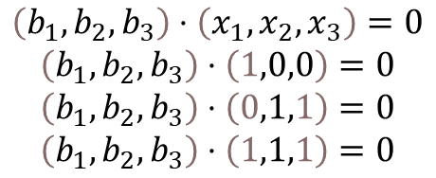
x | f(x)
000 | 010
001 | 101
010 | 101
011 | 010
100 | 110
101 | 001
110 | 001
111 | 110
These states must follow
this system of equations:
0
b1
+
0
b2
+
0
b3
=
0
1
b1
+
0
b2
+
0
b3
=
0
0
b1
+
1
b2
+
1
b3
=
0
1
b1
+
1
b2
+
1
b3
=
0
or
$$\left(b_{1},b_{2},b_{3}\right)⋅\left(x_{1},x_{2},x_{3}\right)=0$$
$$\left(b_{1},b_{2},b_{3}\right)⋅\left(1,0,0\right)=0$$
$$\left(b_{1},b_{2},b_{3}\right)⋅\left(0,1,1\right)=0$$
$$\left(b_{1},b_{2},b_{3}\right)⋅\left(1,1,1\right)=0$$
The possible solutions for the period are: 000 and 011

Slide 21
Thank you for listening

